Slide 1


HIPAA Privacy and Security Training for Staff Members
SBAS
Training Series
Larry C Delone
CHTS-IM, CHPSE

Slide 2
Disclaimer
The information contained in this presentation is provided for information purposes only. While efforts were made to verify the completeness and accuracy of the information contained in this presentation, it is provided “as is” without warranty of any kind, expressed or implied. Any and all information contained herein is not intended to constitute legal advice and accordingly, you should consult with your own attorneys prior to taking action based upon this content. SBAS.info LLC makes no claim, promise, or guarantee of any kind about the accuracy, completeness, or adequacy of the content of this presentation and shall not be responsible for any damages arising out of the use of, or otherwise related to, this presentation or supporting documentation.

Slide 3
Session 1 – Introduction to Privacy and Security
Session 2 – HIPAA Privacy and Security Rule Standards
Session 3 – Methods and Processes that Constitute a Strong Information Security Program

Slide 4
Session 1 – HIPAA Privacy Rule
Session 2 – HIPAA Security Rule Standards
Session 3 – HIPAA Breach Notification Rule
https://www.youtube.com/watch?v=8RGzf0xbUi8
https://www.youtube.com/watch?v=HuEoKsN6RKU

Slide 5

Session 1
Introduction to Privacy and Security
Self Compliance vs. CSF certification

Slide 6
Definitions…..
Confidentiality
Electronic Health Records (EHR)
Electronic Medical Records (EMR)
Audits
Threats
Risk Analysis
Impermissible
Protected Health Information (PHI)
Personally Identifiable Information (PII)
Encryption
Privacy
Safequards
HIPAA
Security
Electronic-Protected Health Information (ePHI)
HITECH
Uses and Disclosures
Vulnerabilities
Covered
Entity
Breach
Health Information Technology (HIT)
OMNIBUS
NPP

Slide 7
Privacy and Security
“Privacy” – an individual’s right to control the use or disclosure of personal information
“Confidentiality” – set of rules or promises that limits access or places restrictions on certain types of information [personal or health]
“Security” – refers to the mechanisms in place to protect the confidentiality and privacy of personal information

Slide 8
EMR vs. EHR
“Electronic Medical Records (EMR)” is a digital version of a paper chart that contains all of a patients medical history from one practice, primarily used by providers for diagnosis and treatment. Information in EMRs don’t typically or easily travel outside provider practice.
“Electronic Health Records (EHR)” are EMRs that focus on total health of patient and goes beyond standard clinical data collected in providers office and includes a broader view of patients care: ie.
Built to share information with other health care providers ie. lab and specialists
Patient information moves with the patient
Patient information is easily shared with all stakeholders

Slide 9
PII vs. PHI
“Personally Identifiable Information (PII)” as used in US Privacy law and information security, is information that can be used on its own or with other information to identify, contact, or locate a single person, or to identify an individual in context. There are approximately 15 primary examples of PII identifiers.
“Protected Health Information (PHI)” is any information about the health status, provision of health care, or payment for health care that can be linked to a specific individual. Under HIPAA, PHI is based upon 18 identifiers.
HIPAA/HITECH laws protect both PII and PHI from unauthorized uses and disclosures-other laws supplement protection provisions

Slide 10
Fifteen (15) PII Examples
Digital Identity
Date of birth
Birthplace
Genetic Information
Login name, screen name, nickname, or handle
Telephone number
Full Name (if not common)
Home Address
Email address
National Identification Number (SSN)
Internet Protocol (IP) address numbers (in some cases)
Vehicle registration plate number
Drivers license number
Face, fingerprints, or handwriting
Credit Card Numbers
Used but less common
Country, State or City of residence
Age
Gender or Race
Name of School
Grades, salary, or job position
Criminal Record

Slide 11
Eighteen (18) ePHI Elements
Name
Address
Dates related to an individual
Telephone numbers
Fax number
Email address
Social Security Number
Medical Record Number
Health plan beneficiary number
Account number
Certificate/license number
Any vehicle or other device serial number
Device identifiers or serial numbers
Web URL
Internet Protocol (IP) address numbers
Finger or voice prints
Photographic images
Any other characteristics that could uniquely identify the individual

Slide 12
Threats and Vulnerabilities
“Threat” is any circumstance or event with the potential to adversely impact assets, operations, individuals or organizations. Threat are categorized by threat sources:
Natural-floods, earthquakes, tornadoes, etc.
Human-enabled or caused by people
Environmental-power failure, pollution, chemical, etc.
“Vulnerability” are flaws or weakness in a systems security system, design, implementation or control that could be intentionally or unintentionally exercised by a “Threat”
“Risk” is the potential impact that a “Threat” can have on the confidentiality, integrity, and availability on ePHI by exploiting a “Vulnerability”

Slide 13
Breach
“Breach” is a impermissible use or disclosure under the Privacy Rule that compromises the security or privacy of the protected health information (PHI). An impermissible use or disclosure of PHI is presumed to be a BREACH unless the ‘covered entity’ demonstrates via a Risk Assessment, that there is a low probability that the PHI has been compromised.
Risk Assessment elements:
The nature and extent of the PHI involved
The unauthorized person who viewed the PHI
Whether the PHI was actually viewed or acquired
The extent to which the risk to the PHI was mitigated

Slide 14
Typical Clinical Operations

Slide 15
Integrating Privacy and Security into Practice
Information Security Program
Protect patients Rights – Uses and Disclosures
Safeguard PHI from unauthorized uses and Disclosures
Develop and Manage Administrative, Technical and Physical Safeguards to protect confidentiality, integrity and availability of ePHI
Physician (s)
Patient’s individually identifiable healthcare information
Patient
PHI or ePHI
Hospital or Other

Slide 16
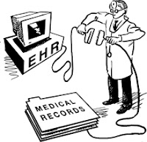
Conversion from Paper to Electronic
Basic Security Rule Principals
PHI must be protected at rest (created or maintained) or transmitted or received
Confidentiality must be protected –”unauthorized use or disclosures”
Integrity must be protected – “free from unauthorized modification or destruction”
Availability must be protected – “information is available to those authorized to access when needed”
Creation of electronic PHI or ePHI

Slide 17
Existing Privacy and Security Mandates
It is a mandate imposed by the Health Insurance Portability and Accountability Act of 1996 (HIPAA) for ‘covered entities’ (health care providers)
HITECH Act improved privacy and security provisions of HIPAA
Omnibus Rule strengthen privacy and security provisions of the HITECH Act
If you are providing customer service as authorized by the Affordable Care Act (ACA), It is a mandate imposed by ACA IAW the MARS-E document suite for protecting the confidentiality, integrity and availability of PII
If you are a participant in CMS’s EHR Meaning Use Incentive payment program, it is a mandate imposed by Core Measure ‘Protect PHI’ objective IAW 45 CFR 164.308(a)(1) – Conduct a thorough Risk Analysis

Slide 18
HIPAA Protocol and Structure
Health Insurance Portability and Accountability Act (HIPAA) of 1996
Administrative Simplification
(Accountability)
Insurance Reform
(Accountability)
Fraud and Abuse
(Accountability)
HITECH
9/2009
OMINBUS
9/2013
Transactions, Code Sets, & Identifiers
Privacy Rule
Security Rule

Slide 19
The Real Reason for Privacy and Security
Many industry experts believe that the mandates merely establishes the “HOW TO”, but the real reason Privacy and Security Matters is:
TRUST by patients that YOU
will honor their Confidentiality!
In the real world, patients/people have a problem sharing sensitive information (specifically health related) if they can’t trust that it will be kept private and secure. When they trust you, they are more willing to discuss ‘accurate’ symptoms, conditions, and past and present risk behaviors!

Slide 20
Addressing Overall Security Compliance
Challenges, old and new!
More policing, more penalties, more regulations – initiated by HIPAA, HITECT, Omnibus-regulated by OCR
Increase reporting of healthcare data breaches – w/significant fines
Tremendous use of mobile devices in healthcare – new technologies, new threats >produces new risks
Greater patient awareness – outreach for patient engagement and satisfaction
More data, more sharing of data, more data on the cloud – changing IT model

Slide 21
Information Security Model
Confidential – Limiting information access and disclosure to authorized users (the right people)
Integrity – Trustworthiness of information resources (no inappropriate changes
Availability – Availability of information resources (at the right time)
Integrity
Information
Confidentiality
Availability

Slide 22
Knowledge Check
In order to participate in the Meaningful Use EHR incentive payment program, which requires that we electronically share medical records with other providers and registries, I need a fully operational electronic medical records (EMR) technology.
True
False
X
False – EMR systems typically are used to collect patient information locally to ones practice. Electronic Health Records (EHR) systems are basically EMRs with the ability to electronically exchange information external to ones practice!

Slide 23
Knowledge Check
A Risk is the potential impact that a “Vulnerability” can have on the confidentiality, integrity, and availability on ePHI by exploiting a “Threat”
True
False
X
False – A “Risk” is the potential impact that a “Threat” can have on the confidentiality, integrity, and availability on ePHI by exploiting a “Vulnerability”

Slide 24
Knowledge Check
HIPAA introduced the Security Rule to establish security measures relevant to protecting PHI in electronic format(s). Which is not one of the three principal rules for protecting ePHI:
Confidentiality
Accessibility
Integrity
Availability
X
The answer is Accessibility - which is NOT one of the three principal rules for protecting ePHI - They are Confidentiality, Integrity and Availability

Slide 25
Session 2
Provide audience with information that details the Health Information Portability and Accountability Act of 1996 (HIPAA) Privacy Rule and Security Rule standards and implementation specifications, including standards and specifications related to both PHI and ePHI. This session will clearly describe the differences between the Privacy Rule and Security Rule as they relate to both PHI and ePHI, and provide a clear understanding of HIPAA in general.

Slide 26
What is HIPAA?
Health Insurance Portability Act of 1996 (HIPAA) is administered by the US Department of Health and Human Services (HHS) and mandates that patient medical records and other healthcare information be protected against security breaches and unauthorized use or disclosure while stored, processed, and exchanged between healthcare organizations and third parties.

Slide 27
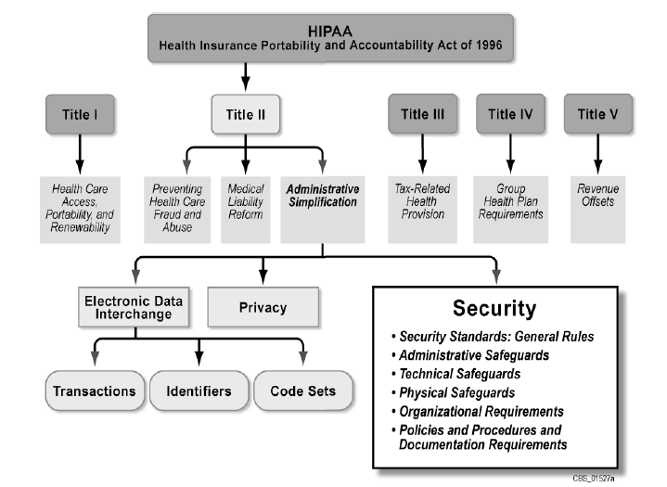
Health Insurance Portability and Accountability Act

Slide 28
Five Major Goals of HIPAA
Make health insurance portable – makes it easier for people to keep health insurance when they change jobs
Reduce healthcare fraud – wastes nearly 1/3 of every dollar spent on healthcare in the US
Improve efficiency – payments, claims, and similar transactions
Protect personal medical information – mandatory privacy and security safeguards
Gather statistical data about diseases – to better protect the public
http://www.youtube.com/watch?v=s_1CZYK8qb8&index=71&list=UUhHTRPxz8awulGaTMh3SAkA

Slide 29
HIPAA Related Rules - Timeline
1996 HIPAA
2003 Privacy Rule
2005 Security Rule
2006 Enforcement Rule
02.2009 HITECH
09.2009 Interim Breach Notification Rule
10.2009 Interim Final Enforcement Rule
07.2010 Proposed Omibus Rule
01.2013 Final Omibus Rule
09.23.2013 Final General Compliance Date (CEs)
09.22.2014 CEs must bring BAAs into compliance

Slide 30
Basic HIPAA Facts
HIPAA is the main U.S. law dealing with medical information privacy
HIPAA laws covers the United States and its territories, ie. Puerto Rico, Guam, the Virgin Islands, American Samoa, and the Northern Marianna Islands
HIPAA applies to all patient data including data about visitors and non-US citizens, (only collected and used in the US and its territories)

Slide 31
Who must be HIPAA Compliant?
In accordance with HIPAA Title II Subtitle F – Administrative Simplification provisions:
The security and privacy of healthcare data apply to “covered entities”, which includes all healthcare organizations that create, receive, maintain, or transmit patient healthcare information.
Healthcare providers
Health plans
Healthcare clearinghouses
Medicare prescription drug card sponsors
Covered business associates

Slide 32
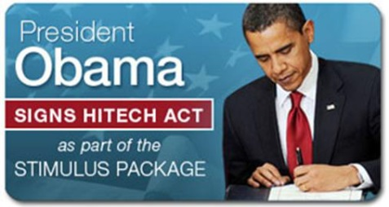
What is HITECH?
The HITECH Act of 2009
The “Health Information Technology for Economic and Clinical Health Act (HITECH Act)”, signed into Law on February 17, 2009 by President Obama, is part of the American Recovery and Reinvestment Act of 2009 (ARRA).
Beginning in 2011, healthcare providers will be offered financial incentives for demonstrating “meaningful use” of EHRs
Improved privacy and security provisions under HIPAA; established new rules for the disclosure of PHI; imposed new notification requirements on covered entities, business associates and vendors
Grants, loans and demonstration programs to assist providers and the health community to adopt, implement, and use certified EHR technology.

Slide 33
Other HITECH Provisions?
New Federal Breach Notification Rule
Applies to all electronic “unsecured Protected Health Information” – “encryption required”
Unauthorized acquisition, access, use or disclosure is presumed to be a reportable breach unless a risk assessment demonstrates a low probability that the PHI was compromised
Requires immediate (60 days) notification to HHS if more than 500 individuals effected
Annual Notification if less that 500 individuals
Requires notification to patients & appropriate remediation
May require notification to a major media outlet and listing on organizations website

Slide 34
2013 HIPAA “Final (Omnibus) Rule
Effective Date [became law] – March 26, 2013
Compliance Date – September 23, 2013
Modified Breach Notification Rule for unsecured PHI
Strengthen Privacy Rule regarding genetic info -GINA
Outlined OCR’s privacy and security enforcement strategies
Elevated Business Associates to same standards for protecting PHI as covered entities
New Patients Rights
Electronic Access to PHI
Right to limit disclosure for services paid out of pocket
Uses & Disclosures of PHI
Fundraising, Marketing, & Sale of PHI
Decedent Information-no longer PHI after 50 years
Student Immunizations-easier for parents w/verbal auth.

Slide 35
Knowledge Check
HIPAA is administered by which Federal Agency:
Department of Commerce (DOC)
Government Accounting Office (GAO)
Health and Human Services (HHS)
Office of Management and Budget (OMB)
X
The answer is HHS (Health and Human Services)- mandates that patient medical records and other health care data be protected against security breaches and unauthorized use or disclosure

Slide 36
Knowledge Check
In accordance with HIPAA Title II Subtitle F – Administrative Simplification provisions - you are considered a “covered entity” if you are a healthcare organization that create, receive, maintain, or transmit patient health care information
True
False
X
True – HIPAA further delineates that all healthcare providers are considered “covered entities”

Slide 37
Knowledge Check
HITECH strengthen the Breach Notification Rule by requiring the immediate notification (30 days) to HHS if more than 500 individuals were effected.
True
False
X
True – Notification to HHS requires immediate notification (60 days).

Slide 38
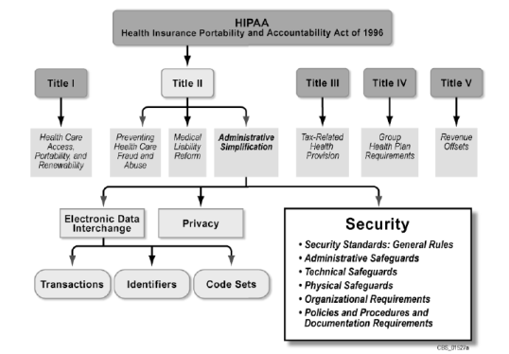

HIPAA - Administrative Simplification
Patient Rights
Privacy Rule
Security Rule
Electronic Transactions and
Code Set Rule
National Identifiers
Breach Notification Rule
Enforcement Rule

Slide 39
Privacy Rule Requirements
The overriding requirement of the Privacy Rule is to reasonably assure that individuals:
Understand their privacy rights
Are allowed access to their medical or claims records
Protects their rights to complain without fear of retaliation
Provides recourse if privacy protection is violated
Defines when a CE may or may not use or disclose patients PHI

Slide 40
Privacy Rule Requirements (cont.)
In addition the Rule is to provide privacy protection without hindering the quality of patient care
Certain provisions have become a matter of statute for Business Associates specifically with regard to the Use and Disclosure provisions
The development of policies, procedures and appropriate safeguards are required by the Privacy Rule
CE’s are now held responsible for working with other CE’s to address violations and breaches

Slide 41
Privacy Rule Provisions
General Principle for Uses and Disclosures
Permitted Uses and Disclosures
Authorized Uses and Disclosures
Limiting Uses and Disclosures to the Minimum Necessary
Notice and Other Individual Rights
Administrative Requirements
Organizational Options
Other Provisions:
Personal Representatives and Minors
State Law
Enforcement and Penalties for Noncompliance
Compliance Dates
Uses and Disclosures
http://www.hhs.gov/ocr/privacy/hipaa/understanding/summary

Slide 42
General Principle – Uses and Disclosures
Basic Principle
CE’s may not use or disclose individual’s PHI except:
As the Privacy Rule permits or requires
As the individual who is subject to the information authorizes in writing
Required Disclosure
A CE must disclose PHI in only two situations:
The individual – when they request access to, or an accounting of disclosures
To HHS – when it is undertaking a compliance investigation or review or enforcement action

Slide 43
Permitted Uses and Disclosures
A CE is permitted, but not required to use and disclose PHI without authorization for the following:
To the individual
Treatment, payment, healthcare operations (TPO)
Uses and disclosures with opportunity to agree or object (informal permission or when individual is incapacitated)
Incidental Use and Disclosure
Public interest and benefit activities > see list*
Limited data sets – PHI with specified direct identifiers removed of individuals, relatives, household members, employers, etc.

Slide 44
*List of Public Interest and Benefit Activities
Required by Law
Public Health Activities
Victims of Abuse, Neglect or Domestic Violence
Health Oversight Activities
Judicial and Administrative Proceedings
Law Enforcement Purposes
Decedents
Cadaveric Organ, Eye or Tissue Donation
Research
Serious Threat to Health or Safety
Essential Government Functions
Worker’s Compensation

Slide 45
Authorized Uses and Disclosures
Authorization – CE must obtain written authorization for use of PHI for non-TPO use- must be written in specific terms and include information to be disclosed, person disclosing and receiving information, expiration, and right to revoke, etc.
Psychotherapy Notes – individual authorization is required except for limited circumstances
Marketing – individual authorization is required except for limited circumstances

Slide 46
Limiting Uses and Disclosures to the Minimum Necessary
The principle of “Minimum Necessary” requires a CE to make reasonable efforts to use, disclose, and request only the minimum amount of PHI needed to accomplish the intended purpose of use, disclosure or request.
Minimum Necessary – policies and procedures required defining implementation
Access and Uses – for internal use, policies and procedures required to restrict access to specific workforce roles
Disclosures and Request for Disclosures – policies and procedures required for routine, recurring disclosures, or requests for disclosures
Reasonable Reliance – If requested by another CE, CE may rely upon assertion that other CE has requested PHI utilizing principal of “Minimum Necessary”

Slide 47
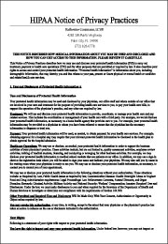
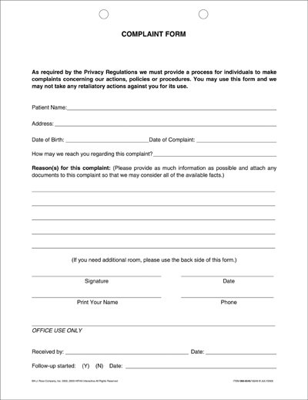
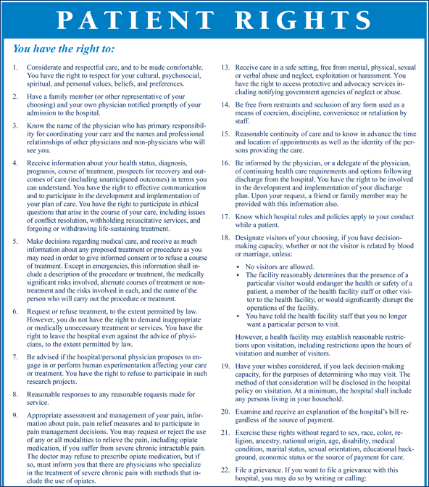
Notices and Other Individual Rights
Notice of Privacy Practice (NPP)
Notice Distribution
Acknowledgement of Notice Receipt
Access
Amendment
Disclosure Accounting
Restriction Request
Confidential Communications Requirement

Slide 48
Administrative Requirements
Privacy Policies and Procedures – must publish
Privacy Personnel – must designate privacy officer
Workforce Training and Management – training for all including volunteers, trainees or others
Mitigation – all suspected or recorded breach conditions
Data Safeguards – security measures whether PHI or ePHI
Complaints – procedures in place
Retaliation and Waiver – by Rule not permitted
Documentation and Record Retention – six years
Fully-insured health group plan exception – specific language (log on to HHS portal)
http://www.hhs.gov/ocr/privacy/hipaa/understanding/summary

Slide 49
Organization Options
Privacy Rule contain provisions that address a variety of organizational issues that allow for tailored or non standard privacy protections and mechanisms:
Hybrid Entity
Affiliated Covered Entity
Organized Health Care Arrangement
Covered Entity with Multiple Covered Entities
Group Health Plan disclosures to Plan Sponsors
http://www.hhs.gov/ocr/privacy/hipaa/understanding/summary

Slide 50
Other Provisions
Personal Representatives and Minors
Personal Representatives
Special Case: Minors
State Law
Preemption
Exception Determination
Enforcement and Penalties
Compliance
Civil Money Penalties
Criminal Penalties

Slide 51

Enforcement and Penalties
Compliance – Office of Civil Rights (OCR) is responsible for enforcing standards
Civil Money Penalties -
 | For violations occurring prior to 2/18/2009 | For violations occurring on or after 2/18/2009
Penalty Amount | Up to $100 per violation | $100 to $50,000 or more per violation
Calendar Year Cap | $25,000 | $1,500,000
Criminal Penalties -
A person who knowingly obtains or discloses individually identifiable health information in violation of HIPAA’s Privacy Rule may face criminal penalty of up to $50,000 and up to one-year imprisonment. [If intent to sell, personal gain or malicious harm, they may face up to $250,000 penalties and 10 years imprisonment].

Slide 52
Other Privacy Laws
State Laws
Gramm-Leach-Bliley Act
Confidentiality of Alcohol and Drug Abuse Patient Records (42 CFR Pt.2)
Red Flag Rule

Slide 53
Knowledge Check
HIPAA is administered by which Federal Agency:
Department of Commerce (DOC)
Government Accounting Office (GAO)
Health and Human Services (HHS)
Office of Management and Budget (OMB)
X
The answer is HHS (Health and Human Services)- mandates that patient medical records and other health care data be protected against security breaches and unauthorized use or disclosure

Slide 54
Knowledge Check
In accordance with HIPAA Title II Subtitle F – Administrative Simplification provisions - you are considered a “covered entity” if you are a healthcare organization that create, receive, maintain, or transmit patient health care information
True
False
X
True – HIPAA further delineates that all healthcare providers are considered “covered entities”

Slide 55

HIPAA - Administrative Simplification
Addresses ePHI only
Privacy Rule
Security Rule
Electronic Transactions and Code Set Rule
National Identifiers
Breach Notification Rule
Enforcement Rule

Slide 56

What Constitute Security Compliance?
Security Rule [electronic PHI ‘ePHI’]
Ensure the “confidentiality, integrity, and availability” of ePHI
Protect ePHI “against any reasonably anticipated threats; and
Protect ePHI against uses or disclosures that are not permitted by HIPAA
The Security Rule protects electronic forms of patient information and covers computers, networks, and any other electronic device that handles or store patient date – i.e. smart phones and other portable devices

Slide 57
Five Categories of Security Rule
Administrative Safeguards
Physical Safeguards
Technical Safeguards
Organizational Requirements
Policies and Procedures and Documentation Requirements

Slide 58
Security Rule Standards
Standards | Sections | Implementation Specifications (R) = Required, (A) = Addressable
Administrative Safeguards
Security Management Process | 164.308(a)(1) | Risk Analysis [R]
 |  | Risk Management [R]
 |  | Sanction Policy [R]
 |  | Information System Activity Review [R]
Assigned Security Responsibility | 164.308(a)(2) | [R]
.
.
Implementation specifications are detailed instructions for implementing a particular Standard.
“Required” – covered entity must implement policies and/or procedures to meet requirements of specification
“Addressable” – covered entity must assess whether it is reasonable and appropriate in the entity’s environment (your organization) . Addressable does not mean optional.

Slide 59

Administrative Safeguards
Security Management Process (S)
Risk Analysis (R)
Risk Management (R)
Sanction Policy (R)
Information System Activity Review (R)
MU Core Measure # 11
Protect electronic PHI - Conduct a security Risk Analysis in accordance with the requirements under 45 CFR 164.308 (a)(1)
In order to ATTEST to MU Stage 1 and Stage 2 Core Measure entitled – “Protect electronic PHI”; providers are required to conduct an accurate and thorough analysis of the potential risks and vulnerabilities to the confidentiality, integrity, and availability of ePHI. <CMS MU security analysis TIP Sheet>
Note: a security risk analysis must be conducted during each reporting period for Stage 1 and Stage 2

Slide 60
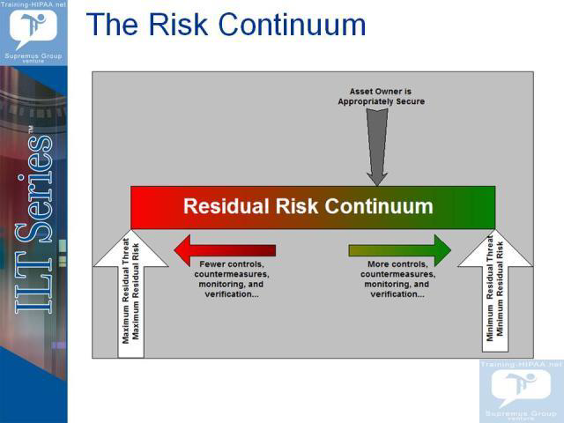
How do we Visualize Risk?
Copyright of the Supremus Group Venture

Slide 61
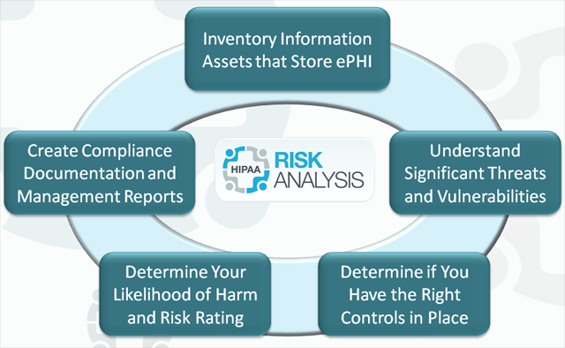


Risk Analysis Process
Vulnerability exploited by Threat = Risk

Slide 62

Risk Analysis Guidelines
NIST
SP800-30
MU Core Measure 11 – “Protect PHI”
Step 1 – System Characterization
Step 2 – Threat Identification
Step 3 – Vulnerability Identification
Step 4 – Control(s) Analysis
Step 5 – Likelihood Determination
Step 6 – Impact Analysis
Step 7 – Risk Determination
Step 8 – Control(s) Recommendations
Step 9 – Results Documentation

Slide 63

Administrative Safeguards (cont.)
Assign Security Responsibility (S)
Identify and Assign Security
Officer (R)
Workforce Security (S)
Authorization and/or Supervision (A)
Workforce clearance procedure (A)
Termination procedure (A)
Information Access Management (S)
Isolating Healthcare Clearinghouse Function (R)
Access Authorization (A)
Access Establishment and Modification (A)

Slide 64
Administrative Safeguards (cont.)
Security Awareness & Training (S)
Security Reminders (A)
Protection from Malicious Software (A)
Log-in Monitoring (A)
Password Management (A)
Security Incident Procedures (S)
Response and Reporting (R)
Contingency Plan(S)
Data back-up Plan (R)
Disaster Recovery Plan (R)
Emergency Mode Operation Plan (R)
Testing and Revision Plan (R)
Evaluation (S)
Technical and Non-Technical Evaluation (R)
Business Associate Contract & Other Arrangements (S)
Written Contract or Other Arrangement

Slide 65


Contingency Plan Standard
“Establish policies and procedures for responding to an emergency or other occurrence (for example, fire, vandalism, system failure, and natural disaster) that damages systems that contain electronic protected health information (ePHI).”
Data back-up Plan (R)
Disaster Recovery Plan (R)
Emergency Mode Operation Plan (R)
Testing and Revision Procedure (A)

Slide 66

Real World Consequences - You never know!

Slide 67
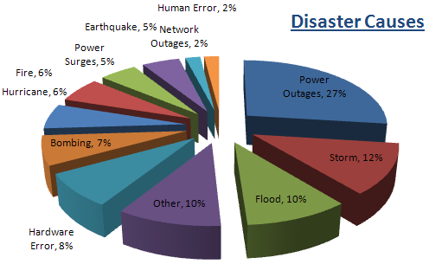
Causes of Disasters

Slide 68
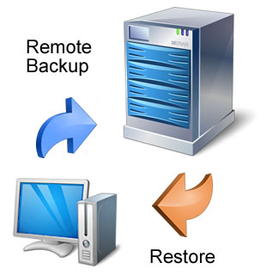
Data Backup
What is the ePHI that must be backed up?
Does the plan include all important sources of data
Has the organization considered the various methods of backups, including tape, disk, or CD?
Does the backup plan include storage of backups in a safe, secure place?
Is the organization’s frequency of backups appropriate for its environment?

Slide 69

Disaster Recovery
Does the disaster recovery plan address issues specific to your operating environment?
Does the plan address what data is to be restored?
Is a copy of the disaster recovery plan readily accessible at more than one location or possibly on-line?

Slide 70
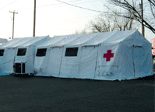
Emergency Mode Operations
Does the organization’s plan balance the need to protect the data with the organization’s need to access the data?
Will alternative security measures be used to protect the EPHI?
Does the emergency mode operation plan include possible manual procedures for security protection that can be implemented as needed?
Does the emergency mode operation plan include telephone numbers and contact names for all persons that must be notified in the event of a disaster, as well as roles and responsibilities of those people involved in the restoration process?

Slide 71

Testing and Revisions Planning
Do those responsible for performing contingency planning tasks understand their responsibilities?
Have those responsible actually performed a test of the procedures?
Have the results of each test been documented and any problems reviewed and corrected?
When determined to be reasonable and appropriate, the testing and revision procedures will vary in frequency and comprehensiveness.

Slide 72
Physical Safeguards
Facility Access Controls (S)
Contingency Operations (A)
Facility Security Plan (A)
Access Control and Validation Procedures (A)
Maintenance Records (A)
Workstation Use (S)
Function and Attributes (R)
Workstation Security (S)
Restrict Access (R)
Device and Media Controls (S)
Disposal (R)
Media Re-use (R)
Accountability (A)
Data back-up and Storage (A)

Slide 73

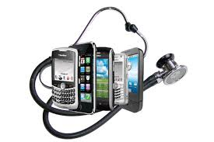
Technical Safeguards
Access Controls (S)
Unique User Identification (R)
Emergency Access Procedure (R)
Automatic Log-off (A)
Encryption and Decryption (A)*
Audit Controls (S)(R)
Integrity (S)
Mechanism to Authenticate electronic PHI (A)
Person or Entity Authentication (S)(R)
Transmission Security
Integrity Controls (A)
Encryption (A)*
*Addressable, but an absolute must for meeting MU Protect PHI requirement for data at rest or in transit

Slide 74

Other Security Rule Requirements
Organizational Requirements
Business Associate Contracts or Other Agreements
Business Associate Contracts (R)
Other Agreements (R)
Requirements for Group Health Plans (R)
Policies & Procedures and Documentation Requirements
Policies and Procedures
Documentation
Time Limit (R)
Availability (R)
Updates (R)

Slide 75
Knowledge Check
HIPAA is administered by which Federal Agency:
Department of Commerce (DOC)
Government Accounting Office (GAO)
Health and Human Services (HHS)
Office of Management and Budget (OMB)
X
The answer is HHS (Health and Human Services)- mandates that patient medical records and other health care data be protected against security breaches and unauthorized use or disclosure

Slide 76
Knowledge Check
In accordance with HIPAA Title II Subtitle F – Administrative Simplification provisions - you are considered a “covered entity” if you are a healthcare organization that create, receive, maintain, or transmit patient health care information
True
False
X
True – HIPAA further delineates that all healthcare providers are considered “covered entities”

Slide 77
HIPAA - Administrative Simplification
Privacy Rule
Security Rule
Electronic Transactions and
Code Set Rule
National Identifiers
Breach Notification Rule
Enforcement Rule

Slide 78
Breach Notification Rule
--Requires Covered entities and Business Associates to provide notification following a breach of unsecured PHI--
“Breach” – unauthorized acquisition, access, use, disclosure of unsecured PHI
“Unsecured PHI” – PHI that has not been rendered unusable, unreadable, or indecipherable to unauthorized individuals
Burden of proof is on the CE or BA

Slide 79
Breach Notification Requirements
Covered entity must provide notification following a breach of unsecured protected health information as follows:
Individual Notice
In written form ie. first class mail or email
Must occur no later than 60 days
Media Notice
Breach effecting >500 individuals NLT 60 days
Notice to the Secretary
Breach effecting >500 individuals NLT 60 days
Breach effecting <500 individuals; annually
Notification by a Business Associate
Notify CE NLT 60 days; CE or BA may notify individual

Slide 80
Risk Assessment - Breach
The impermissible use of PHI under the Privacy Rule is assumed to be a “breach” unless the CE Or BA perform a Risk Assessment on the following factors:
The nature and extent of the PHI involved
The unauthorized person who used the PHI
Whether the PHI was actually acquired or viewed
The extent to which the PHI has been mitigated

Slide 81

Breach Notification Highlights*?
571 reports involving over 500 individuals
Over 79,000 reports involving under 500 individuals
Top types of large breaches
Theft
Unauthorized access/disclosures
Loss
Top locations for large breaches
Laptops
Paper records
Desktop computers
Portable electronic devices
*Data extracted from Office of Civil Rights Briefing/Reports
September 2009 thru April 15, 2013

Slide 82
Breach Notification Highlights*?
*Data extracted from Office of Civil Rights Briefing/Reports
September 2009 thru April 15, 2013

Slide 83
Breach Notification Highlights*?
*Data extracted from Office of Civil Rights Briefing/Reports
September 2009 thru April 15, 2013

Slide 84
Knowledge Check
HIPAA is administered by which Federal Agency:
Department of Commerce (DOC)
Government Accounting Office (GAO)
Health and Human Services (HHS)
Office of Management and Budget (OMB)
X
The answer is HHS (Health and Human Services)- mandates that patient medical records and other health care data be protected against security breaches and unauthorized use or disclosure

Slide 85
Knowledge Check
In accordance with HIPAA Title II Subtitle F – Administrative Simplification provisions - you are considered a “covered entity” if you are a healthcare organization that create, receive, maintain, or transmit patient health care information
True
False
X
True – HIPAA further delineates that all healthcare providers are considered “covered entities”

Slide 86

HIPAA - Administrative Simplification
Privacy Rule
Security Rule
Electronic Transactions and
Code Set Rule
National Identifiers
Breach Notification Rule
Enforcement Rule

Slide 87
Enforcement Rule
HITECH Act of 2009 strengthen provisions for civil and criminal enforcement for violations of HIPAA Administrative Simplification Rules by establishing:
Four categories of violations reflecting increasing levels of culpability
Four corresponding tiers of penalty amounts
A maximum penalty amount of $1.5 million
Eliminated the exception on “did not know” or “would not have known” provisions previously acceptable
Prohibits imposing penalties if violation is corrected within 30 days (if not due to willful neglect)

Slide 88
HIPAA Penalties
The minimum fine for a minor HIPAA violation is $100/violation
The maximum fine for a serious HIPAA violation is $50,000/violation – capped at $1.5 million per year
Criminal HIPAA violations can also include prison sentences up to ten years per violation
Because ePHI resides on computers/smart devices, everyone using them must practice “safe computing” at all times!!

Slide 89
Knowledge Check
HIPAA is administered by which Federal Agency:
Department of Commerce (DOC)
Government Accounting Office (GAO)
Health and Human Services (HHS)
Office of Management and Budget (OMB)
X
The answer is HHS (Health and Human Services)- mandates that patient medical records and other health care data be protected against security breaches and unauthorized use or disclosure

Slide 90
Knowledge Check
In accordance with HIPAA Title II Subtitle F – Administrative Simplification provisions - you are considered a “covered entity” if you are a healthcare organization that create, receive, maintain, or transmit patient health care information
True
False
X
True – HIPAA further delineates that all healthcare providers are considered “covered entities”

Slide 91
Session 3
Discuss methods and processes to establish a framework for developing and implementing a Privacy and Security Program that demonstrates a “culture of compliance” at the organizational level; and specifically discuss techniques that are required to meet Safeguard Standards that address technology advancements inherent in EMR/EHR technologies.

Slide 92
Effective Security Program
Risk Management
Inventory assets vulnerable to risks, Analyze and quantify risks, perform threat and vulnerability analysis, assess non-technical and technical risk mitigation strategies
Security Governance
Assign security responsibilities, develop policies and procedures, institute internal and external audit processes
Security Operations
Establish processes to safeguard ePHI, implement policy and procedural instructions, monitor effectiveness of all safeguards established
Security Awareness
Provide initial and periodic HIPAA awareness training to workforce members, provide safeguard specific training as required, establish communication channels and venues for discussing trends, updates and compliance progress/challenges

Slide 93

Risk Management
Risk Management
Inventory assets vulnerable to risks, Analyze and quantify risks, perform threat and vulnerability analysis, assess non-technical and technical risk mitigation strategies
Risk Management is a key component of the “Security Management Process” Standard which also includes the Risk Analysis Implementation Specification.
Your resulting Information Security Program hinges on the results discovered after you’ve conducted a thorough Risk Analysis* of your operations to:
a) identify potential security risks and
b) Determine the probability of occurrence and magnitude of these risks to
c) Implement security measures to reduce or mitigate these risks and/or vulnerabilities uncovered
Risk Analysis
Vulnerability exploited by Threat = Risk
Risk Management
*Key component of Meaningful Use Program

Slide 94

Security Governance
Security Governance
Assign security responsibilities, develop policies and procedures, institute internal and external audit processes
The “Assign Security Responsibility” Standard stands alone and instructs that – a covered entity must assign the security responsibility to an individual to assure that the CE complies with both the Privacy and Security Rule.
A complete suite of policies, procedures and forms comprises evidence of an effective Security Program and must be managed by the Security official.

Slide 95

Security Operations
Security Operations
Establish processes to safeguard ePHI, implement policy and procedural instructions, monitor effectiveness of all safeguards established
Access controls, person or entity authentication, workstation use, transmission security and all other operational related security measures will be carried out routinely and effectively by personnel in an organization that promotes a “Culture of Compliance” philosophy.

Slide 96

Security Awareness
Security Awareness
Provide initial and periodic HIPAA awareness training to workforce members, provide safeguard specific training as required, establish communication channels and venues for discussing trends, updates and compliance progress/challenges
HIPAA
YOU cannot document or publish enough policies and procedures to mitigate “Breaches” and/or impermissible uses and disclosures of PHI or ePHI, if your workforce is not properly trained or receive periodic refresher HIPAA awareness and security measures training. This is a firm requirement and evidence that supports its implementation will be evaluated by OCR in the event of an audit, or if a “Breach” occurs and a determination of willful neglect is under evaluation.

Slide 97
New Privacy Rule Challenge
Managing a patient’s right to request restrictions of Disclosures….
HIPAA-Omnibus Rule, effective Sept 2013, “requires that a CE must agree to request of patient to restrict disclosure of PHI about patient to health plan if the disclosure is for the purposes of carrying out payment or health care operations and not otherwise required by law—and the PHI pertains solely to a health care item or service for which the patient has paid the CE in full”.

Slide 98
Privacy Rule Challenge (cont.)
Managing a patient’s right to request restrictions of Disclosures......
Re-evaluate Workflow for Challenges
Preparing for receiving request for restriction
Defining Documentation for request for restriction
Notifying Workflow members of restriction protocols
Responding to request for restriction
Reviewing contracts for impact
Terminating a restriction to a health plan
Educating patients on restriction limitations
EHR documentation/interoperability impacts

Slide 99
“Safe Computing” Guidelines
Never access medical or billing records for family, friends or others unless authorized
Use strong passwords and timed screen savers
Don’t access a computer or patient data using someone else’ password
Don’t leave e-PHI open when you walk away
Scan for viruses, spyware, and other threats before installing new data or programs
Use encryption for transmitting e-PHI and also e-PHI at rest
Always close, file, lock or shred or properly dispose of e-PHI when done
Beware of hackers or scammers impersonating staff
Verify identities before giving access to PHI or e-PHI

Slide 100
Evidence of Compliance Tips
Looks for….
Easily assessable HIPAA Privacy, Security, Breach policies and procedures along with other related documents, specifically updated to reflect latest Omnibus Rule additions
Perform at least annually, a security Risk Analysis and document results along with corrective action/new security measures plans
Develop Comprehensive Contingency Planning documents and make assessable to all responsible workforce members, perform tests/walkthrough of Emergency Operations Plan and document results
Evidence of Workforce Awareness/refresher training activities
Evidence of Audit log reports/results
Develop Audit monitoring plan (internal and external audits) and document/show results
*As reported by health care attorney Susan Miller – “national HIPAA/HITECH Act health care expert, Concord MA”

Slide 101
Knowledge Check
HIPAA is administered by which Federal Agency:
Department of Commerce (DOC)
Government Accounting Office (GAO)
Health and Human Services (HHS)
Office of Management and Budget (OMB)
X
The answer is HHS (Health and Human Services)- mandates that patient medical records and other health care data be protected against security breaches and unauthorized use or disclosure

Slide 102
Knowledge Check
In accordance with HIPAA Title II Subtitle F – Administrative Simplification provisions - you are considered a “covered entity” if you are a healthcare organization that create, receive, maintain, or transmit patient health care information
True
False
X
True – HIPAA further delineates that all healthcare providers are considered “covered entities”

Slide 103

Questions

